Slide 1
Capgemini’s Oracle Service Line Overview
January, 2015

Slide 2


Our Brand Promise
“It is the quality of our people, and their capacity to deliver tailored solutions, with you and for you, that drive real business results.”

Slide 3
Table of Contents
Capgemini Oracle Practice Overview
Analyst Reporting
Methodology & Delivery Models
Solutions & Accelerators

Slide 4


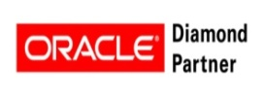
Capgemini – Global Oracle Overview
Over 13,000 Oracle trained resources including 70% + Oracle certified consultants.
Over 4,000 successful implementations of Oracle applications across all industry sectors. Ensuring the quality of delivery through various dedicated Delivery centers, CoEs and various Capgemini’s innovative methodologies (Rightshore®, Rapid, ASE® and more)
Capgemini is the first among all our competitors globally to adopt Oracle Unified Methods (OUM) and become certified as trainers on OUM
15+ Oracle Approved Solutions globally and expertise spread throughout the Americas, Europe, Asia Pac, etc. With 20+demo centers and 20+ CoEs Worldwide.
Capgemini is recognized as a Diamond Level Partner of Oracle, which is the highest of the OPN status.
Over 30 specializations with 13 advanced specializations on Oracle applications, middleware and technology.

Slide 5
Oracle Awards & Certifications Diamond Partner
Oracle Advanced Certifications
Oracle Fusion CRM
Oracle Fusion HCM
Oracle Business Intelligence Foundation
Oracle Business Intelligence Application
Oracle Database
Oracle E-Business Suite Financial Management
Oracle E-Business Suites SCM R12
Oracle Service Oriented Architecture 11g
People Soft Human Capital Management
People Soft People Tools
Siebel CRM
Oracle Solaris 10
Java Standard Edition 5/6
Oracle Basic Certifications
Oracle UBPM
Oracle Exadata
Oracle Application Grid
Oracle Documaker 12
Oracle Real Application Clusters
PeopleSoft PeopleTools
Oracle CRM OnDemand
Oracle Data Warehousing
JD Edwards EnterpriseOne CNC
Oracle E-Business Suite Supply Chain Management
Aerospace and Defense
Consumer Goods
Education and Research
Natural Resources
Wholesale Distribution
Professional Services
Public Sector
Oil and Gas
Wholesale Distribution
Healthcare
Recent Awards and Recognition
2014 – Nederlands B.V. - Specialized Partner of the Year for Applications
2014 – Capgemini France - Specialized Partner of the Year in Business Analytics
2014 -Capgemini Spain – Oracle Excellence Award in BI and EPM
2014- Michelin Project – Digital Transformation Award by Oracle
2013-Capgemini UK – Specialized Partner of the Year
for Applications
2013 – Capgemini Spain – Partnering Excellence Award.
2012 Oracle Excellence Award: Specialized Partner of the Year: “Oracle on Oracle” - GLOBAL
2012 Fusion Middleware partner of the year by Capgemini NL
2012 Oracle Applications Partner of the year by Capgemini Norway
2012 “Oracle on Oracle” award by Capgemini Spain (rolled up to global)
2012 Oracle Applications Partner of the Year – Capgemini Belgium

Slide 6
Oracle Resources are Spread Across the Globe
With more than 130,000 people in over 40 countries, Capgemini is one of the world's foremost providers of consulting, technology and outsourcing services. The Group reported 2013 global revenues of €10.1 billion (more than $13 billion USD).
13,000+ Global Oracle Resources
North America 2,800+
EMEA
5,200+
Asia Pacific
3,500+
Latin America
1,500+
Over 70% Oracle Certified Resources
1,300+ Certified Consultants on Oracle Fusion Applications
Notes:
6
© 2009 Capgemini. All rights reserved
6

Slide 7






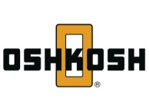




Comprehensive Portfolio of Oracle Solutions
Consulting Services | Implementation Services | Application Management | Infrastructure Management
Business consulting: transforms companies digital landscape | Broad capabilities within the Oracle services offering | Enhancing effectiveness and efficiency | Delivering improved performance and reduced costs
Digital transformation Big Data & Analytics Consulting Finance Transformation Customer Experience HR Transformation Strategy & Transformation Supply Chain Management Business & Technology Innovation | Process Redefinition Implementation and Integration Oracle Application and Technical Upgrades and Re-implementation Program management Training/Change management Implementation deployment/rollout Strategy Existing Oracle System optimizations E-Business Suite, PeopleSoft, JDE, Siebel, BIM, Cloud Technologies, Engineered Systems, Supply Chain Enhanced Reporting/Executive management Reporting | Level 1, 2, and 3 Support: Basic Application 100% Dedicated Support Team Support, master Data, Complete Development Database & Security Administration Flexible, remote or on-site resources to provide help desk or small project support. Support plans allow support with part-time resources, as low as 40 hours a month. Level agreements enable prompt response time and available skills | Hybrid infrastructure combinations via “COMPLETE” platform Scalability via public or private Cloud, on or off-premise Technical Account Management Development, QA & Production Environments Change Management Oracle Technical, OS, DB & Basis Administration Backup and Recovery System Monitoring Disk Storage Services Continuous Software Maintenance Services Disaster Recovery Solutions Network Management

Slide 8
Capgemini is A World Leader in Oracle E-Business Suite
3,000+ skilled and experienced EBS consultants worldwide (functional and technical), 500+ in the US, over 80% of them have R12 experiences
2,200+ Oracle E-Business Suites (EBS) Applications engagements successfully completed across all industry sectors for over 1,500 clients
Functional & technical experience across all modules (HRMS, Financials, Supply Chain Management, CRM, E&G, ESA, and EPM)
70%+ consultants are Oracle certified, average 7+ years of experience
Experience
Global Delivery
Offshore Delivery capabilities for Oracle including India with 1,500+ EBS resources (functional and technical)
Provides 24/7 coverage at a lower cost
Oracle Competency Centers
Oracle competency centers in the US, UK, Italy, France, the Netherlands, Germany, Spain, India, Singapore and New Zealand, with dedicated staff focused on the accelerated delivery of Oracle solutions
Capgemini has U.S. and India EBS Centers of Excellence (CoE) designed to be an ERP solution center available for our EBS engagements
Testing Centers of Excellence
Upgrade Labs
Center of Excellence

Slide 9


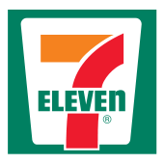
















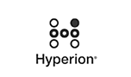
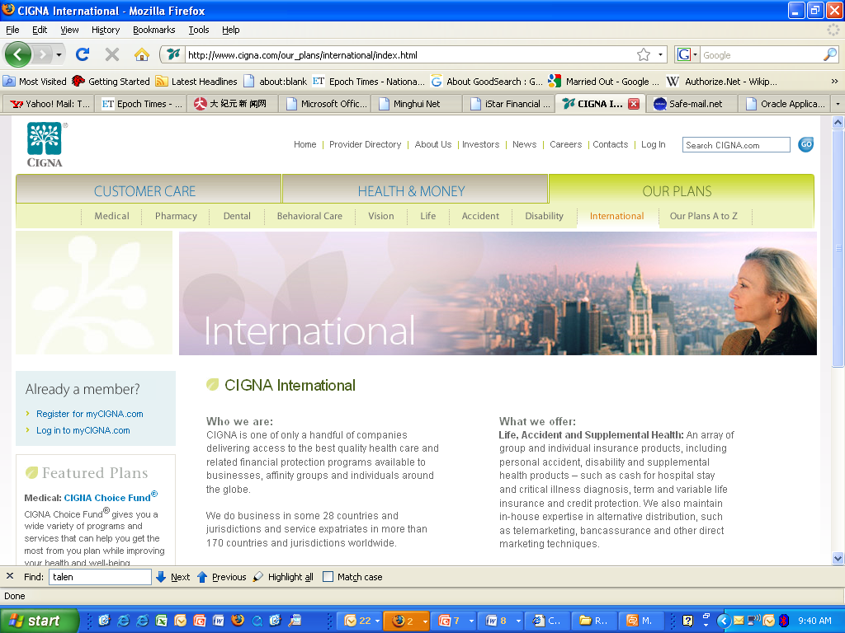


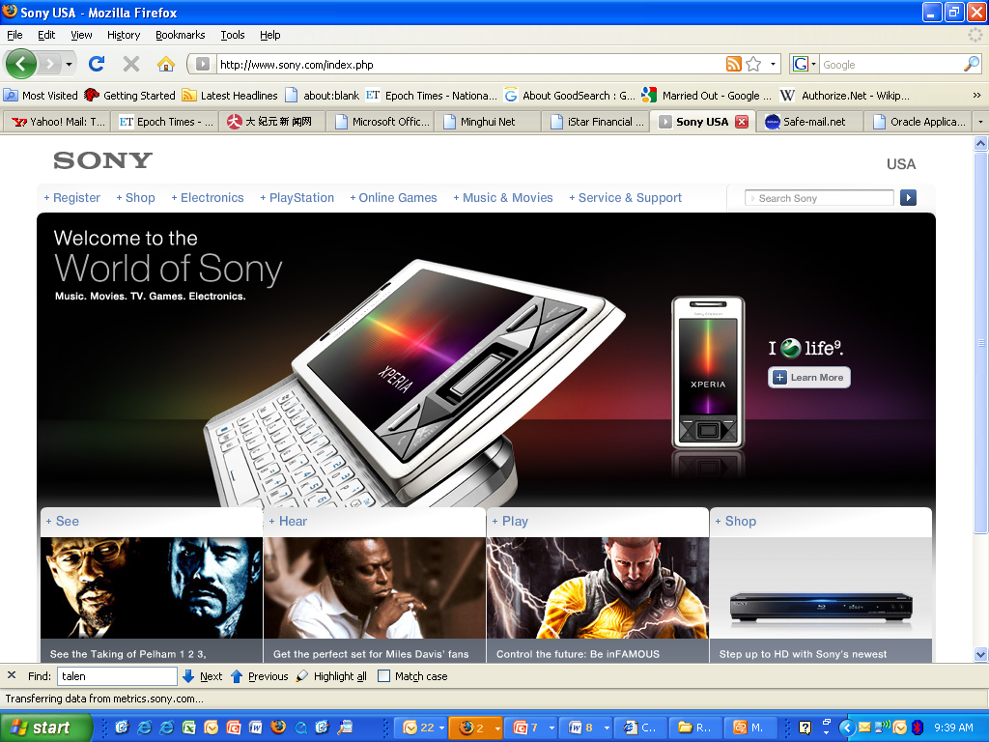

















We Work with Leading Global Companies to Implement EBS

Slide 10
Capgemini’s PeopleSoft Enterprise Capabilities
Global Delivery
Extensive Breadth of Experience
Global Alliance Partner
Capgemini has implemented PeopleSoft in over 100 countries
Deep & wide breadth of experience with PeopleSoft Centers of Excellence in both the US & India
Our Rightshore® global delivery model ensures the right combination of on-shore, near-shore & off-shore
Hosting facilities in U.S., Europe & India
Over 1,200 PeopleSoft projects; more than 300 in the last 3 years
Over 2,000 skilled and experienced PeopleSoft consultants worldwide, with over 300 in North America, over 700 Rightshore® resources
Over 800 satisfied PeopleSoft clients across the world
Upgrade Lab specializing in PeopleSoft Enterprise upgrades & support
Capgemini has been a PeopleSoft global alliance partner since 1991
First Globally Certified PeopleSoft Practice
Consistently rank among the top PeopleSoft integrators in the world

Slide 11


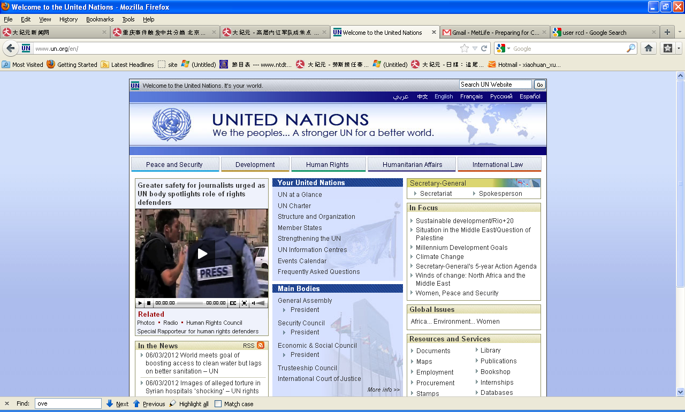














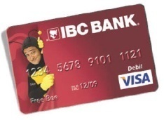
















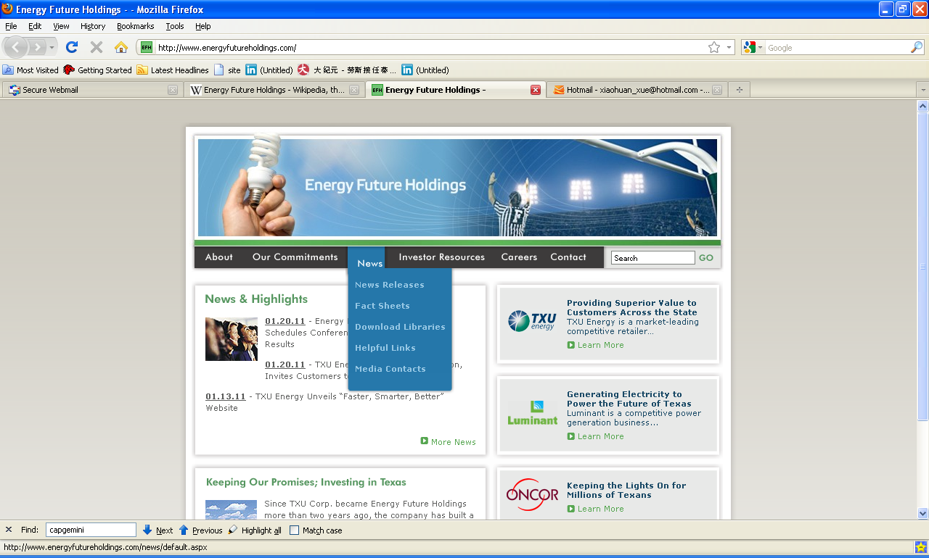
















We Have Extensive Experience with PeopleSoft Human Resources…
You MUST confirm with the Account Executives that these client logos can still be used externally in a proposal.

Slide 12







Capgemini’s Business Information Management (BIM) Practice
Leader
Market leader for Oracle BI in North America
Technology | Right shore | Global
Ab Initio | 62 | 194
IBM + Cognos | 364 | 961
Informatica | 448 | 1,007
Microsoft | 55 | 437
Oracle BI + Hyperion | 515 | 1,013
SAP + Business Objects | 598 | 1,928
SAS | 302 | 753
Teradata | 73 | 289
Other, e.g., Qlikview | 29 | 440
Total | 2427 | 7022
Scale
Operations in 36 countries and a focus on BIM with over 7,000 BIM practitioners
Global Delivery
Best-in-class Rightshore® capability for development and management of BIM solutions improves quality
Accelerators
BI methodology and frameworks, and reference data architectures allow Capgemini to lower cost and time to value
Methodology
DELIVER Methodology provides a comprehensive roadmap that accelerates delivery
Experience
Worked with all the major software vendors to deliver solutions appropriate to the customer’s needs
Some of our Strategic Partners in Business Information Management

Slide 13
Capgemini’s Oracle Analytics Competency
Product Portfolio
Roles
Resource Numbers - 1,013
OBIEE
OBIEE Applications
OBIEE Migrations/Upgrades
Brio/HFR
Report Migrations
Hyperion Planning, Capital Asset Planning, Workforce Planning
Hyperion Financial Management (HFM)
Hyperion Financial Data Quality Mgt
Hyperion DRM/MDM
Hyperion Essbase
Oracle Database
Oracle Data Integrator Enterprise Edition
Solution Architects
Project Managers
Technical Architects/SMEs
Performance Management Specialists
Oracle MDM Specialists
BI/EPM Developers
ODI Developers
Senior Managers & Above 031
Managers 060
Senior Consultants 304
Consultants 475
Associate Consultants 143
Sample Case Studies
IT Research & Advisory Major
Implementation of OBIEE providing scorecard, incentive reporting capabilities as well as daily operational reports to reduce manual development of analytical outcomes
Service Offerings
Consulting Services
Upgrades
Installation & configuration
Architecture & Design Services
ETL & Reporting Development
Data Management Solutions
Performance Management
Testing
Application Management Services
Real Estate Conglomerate
Development and support of Hyperion platform that covered Enterprise Planning and budgeting; and also to consolidate budgets from the different companies of the corporation.
Leading Automotive Group
Implementation of a Hyperion application suite supporting formation and editing process of the group managerial consolidated financial state
Awards
Premier Mortgage Organization in the U.S.
Making Data Work for Better Decision Making by to streamlining the Extract, Transform and Loading (ETL) processes using Oracle Warehouse Builder (OWB) for pulling the data from disparate source systems
North American Oracle BI / EPM partner of the year in 2007, 2008, and 2009
Oracle Innovation Award in 2010
Successfully completed over 400 Oracle BI, BI Apps, Data Warehousing, and EPM projects
Global Oilfield Service Company
Implemented Hyperion Enterprise & Essbase OLAP to facilitate faster and accurate consolidation of monthly Financials as well as Financial process reengineering to remove non-value adding activities.

Slide 14
Capgemini is A World Leader in Oracle JDE
Experience
Strong client base with 100+ JDE implementations
150 consultants with extensive knowledge across various industries, with average 7 years of experience
Purchased a leading JDE implementer in The Netherlands
Global Delivery
Offshore Delivery capabilities
Provides 24/7 coverage at a lower cost
Solution & Methodology
Multiple offerings including pre-configured solutions, implementations, upgrades, testing, consolidation and application management
Proven methodology based on Oracle Unified Method
Ready-to-use JDE tools and accelerators.
Center of Excellence
& Support Desk
Capgemini has JDE Center of Excellence (CoE) available to all Capgemini JDE engagements. The COE provides fully configured test labs for demos, training and remote development

Slide 15




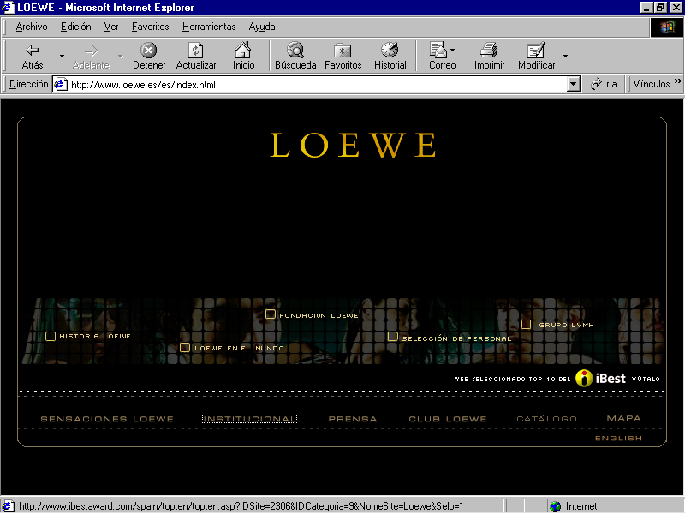















We work with leading global companies to implement JDE
You MUST confirm with the Account Executives that these client logos can still be used externally in a proposal.
You MUST confirm with the Account Executives that these client logos can still be used externally in a proposal.

Slide 16
Our CRM Offerings Include Strategy, Implementation, Upgrades, Data and Support Services
Strategy & Roadmap Initiatives
Helping clients with CRM Strategy, Customer Experience Analysis, and Roadmaps. We help our clients to plan, evolve and differentiate themselves beyond price and product
SaaS & On-Premise Implementations
Our Oracle CRM On-Demand (SaaS) and Siebel On-Premise solutions via Capgemini’s Rightshore® Distributed Delivery Framework (DDF) is recognized for quality, speed and value
350+ Implementations including Siebel On-Premise, On-Demand, Upgrades and Master Data Solutions
Value Added Upgrades / Extension
Our Value Added Upgrade approach to Siebel positions our clients to extend functionality and maximize their investment in Oracle solutions
BI / Master Data Management / Integration
Business Intelligence and Master Data Management / Integration allows our clients to see a single, accurate and complete view of operational data spanning multiple sources and lines of business
Hosting, AM, IM and BPO
Capgemini takes on responsibility for Hosting, Application Management and / or Business Process so our clients can spend more time helping the business achieve strategic, tactical and financial objectives

Slide 17








































And Leveraging our CRM Experiences Across Multiple Verticals
You MUST confirm with the Account Executives that these client logos can still be used externally in a proposal.

Slide 18

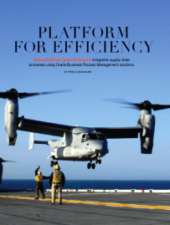
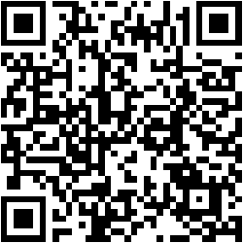
Accelerating Innovation for our clients with Cloud Strategy
HCM Cloud
Cx Cloud
ERP Cloud
Oracle Fusion
Supply Chain
Management (SCM)
Oracle Fusion Applications have a foundation in business processes, a base in SOA, and cutting-edge functionalities, including embedded analytics, built-in social media, and unparalleled usability.
Capgemini is one of Oracle's first global installation partners qualified to install Oracle Fusion Applications.
Capgemini’s IMPACT (Integrated Method for Proven, Accelerated Cloud Transformation) is an accelerated approach and methodology to quickly configure, align and leverage Oracle Cloud Applications
Snap here to learn about our Oracle Fusion SCM project with Boeing
Oracle Fusion/Cloud Applications Practice
Extended Oracle Cloud Practice (non-Fusion)
More than 1,300 certifications across Fusion Applications globally
One of the first global SI partners to invest and develop an Oracle Fusion Applications Center of Excellence
First round BETA partner of Fusion Applications in 2009 with significant investment in training, testing and Center of Excellence best practice development for installation/configuration.
Advanced specialized certification on Oracle SOA with comprehensive toolkit for deployments
Successful IMPACT deliveries for Sales Cloud and HCM Cloud
Many global Oracle Fusion Applications successes/references
More than 400 certifications and global support covering non-Fusion Oracle Cloud offerings:
Service Cloud
Right Now and Oracle Policy Automation
Marketing Cloud
CPQ Cloud
Social Cloud
Enterprise Performance Cloud
Platform as a Service (PaaS)
Capgemini is a featured global SI on Oracle’s Cloud Marketplace

Slide 19
Table of Contents
Capgemini Oracle Practice Overview
Analyst Reporting
Methodology & Delivery Models
Solutions & Accelerators

Slide 20
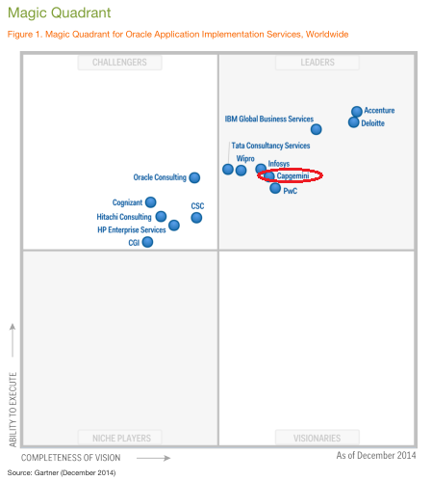
Capgemini: A leader in Gartner Magic Quadrant for Oracle Implementation Services, Worldwide 2014
Position
Capgemini is positioned in the Leaders quadrant. It is a global firm with an estimated worldwidetotal of 7,400 FTEs across all Oracle application services
Capgemini “consistently ranks well in Gartner evaluations for finance, CRM and business analytics capabilities that are important in many application engagements.
Gartner Excerpts
Capgemini is an Oracle Diamond Partner. It has extensive life cycle service capabilities to design, implement and manage Oracle applications of E-Business Suite, JD Edwards, Fusion Applications, PeopleSoft and Siebel, and it has the methodologies and proprietary tools necessary to establish and execute a comprehensive life cycle program.”
Strengths
Geographic delivery — Capgemini offers Oracle services in multiple locations, including North America, Latin America, the U.K., France and the Benelux, although its primary strength continues to be in the Western European market. The provider has strong local capabilities in this region in combination with its Rightshore global delivery model.
Oracle portfolio — Capgemini provides Oracle services across the spectrum of consulting, implementation and application management. The practice is supported by intellectual property (IP), accelerators, marketing and sales execution.
Commitment and proactive approach — Capgemini client references spoke of a high level of commitment to their projects with effective problem solving and a "can do" mentality with a big personal commitment of its employees. Client also liked that Capgemini presented them with continuous improvement, ideas and suggestions.
Magic Quadrant Oracle Implementation Services, worldwide 2014
*Based on Gartner Report Dated December, 2014

Slide 21
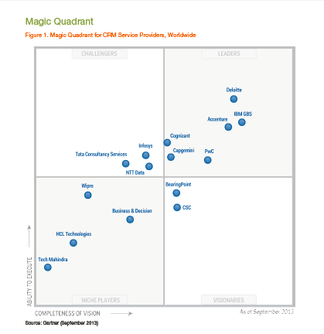
Capgemini: A leader in Gartner Magic Quadrant for CRM service providers, worldwide 2013
Magic Quadrant for CRM Service Providers, Worldwide 2013
Position
Capgemini is a good fit for enterprises in the U.S. or Western Europe seeking help with large-scale or complex projects needing both CRM technical advisory and implementation skills.
Gartner Excerpts
Gartner estimates that Capgemini is the fifth largest CRM service provider worldwide, with CRM revenue estimated to be about $1 billion (accounting for about 17% of its consulting and technology service revenue).
Strengths
Customer referral — In our reference checks, Capgemini had high scores related to customer loyalty, reflected in references' potential to rehire as well as willingness to recommend the firm to a friend or colleague. References also cited prior experience with Capgemini as a reason for rehiring.
Industry focus — Reference checks cited Capgemini consultants' competencies, industry experience and project teams as a leading reason for selection. This strength is specific to CRM-technology-based solutions for the industry.
Technical competencies — Capgemini has more than 6,000 CRM consultants, and most of these are trained on SAP, Oracle, salesforce.com or Microsoft CRM. Capgemini has large practices related to each CRM platform and experience with how these platforms are applied within selected industries.
Integrated delivery model — Integrated delivery model — Capgemini's delivery model is a competitive differentiator in the U.S., the U.K. and the Netherlands.
*Based on Gartner Report Dated September, 2013

Slide 22
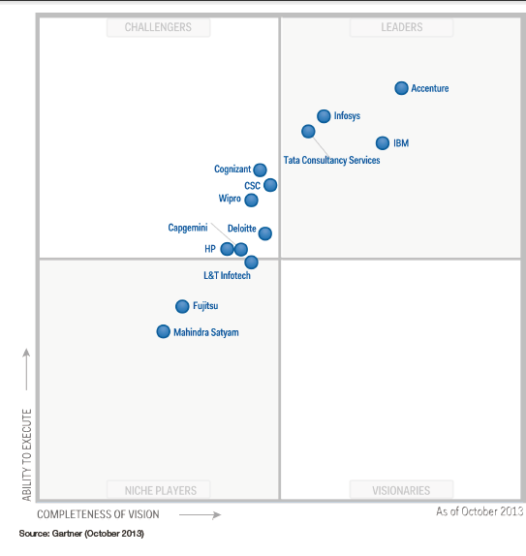
Capgemini: A challenger in Gartner’s Magic Quadrant for Oracle AM service providers, worldwide 2013
Magic Quadrant for AM service providers, worldwide 2013
Gartner Excerpts
Gartner estimates that Capgemini has approximately 1,800 FTEs dedicated to Oracle management services.
Capgemini services 17 of the 22 industries covered in this Magic Quadrant.
Strengths:
Capgemini demonstrates worldwide Oracle management capabilities, with revenue streams in all regions. Although still relatively small in emerging markets, Capgemini has been able to almost double its revenue in the smaller regions of LATAM and APJ.
Capgemini has improved its position in BI and Fusion services. It has identified distinct industry mobility solutions for vertical markets such as manufacturing, retail, the public sector and utilities as a core focus. In addition, for industries like discrete manufacturing Capgemini has expanded its coverage across IT and operational technology assets to generate engineering solutions. As a growing focus, Capgemini is increasing its investments in Fusion applications for SCM.
Capgemini's SingleSource life cycle model for Oracle applications remains a sustainable approach to delivering a complete Oracle service stack in a transparent manner. This model enables selection of service components from hosting to value management, each with defined service elements, metrics and pricing. A focus area for Capgemini is value management and acceleration of ROI.
Capgemini's clients appreciate its professional behavior and work ethic. This includes the transparency of its processes and delivery throughout the life cycle of services.
* Magic Quadrant for Application Management Service Providers,
Worldwide 2013

Slide 23
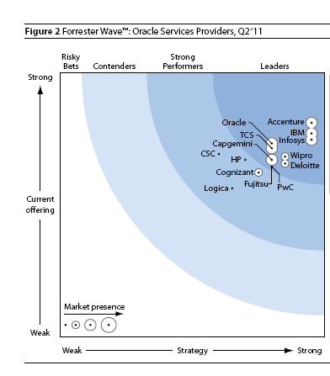
Capgemini Positioned as a Leader in Forrester’s Oracle Services Providers
The Forrester Wave™: Oracle Services Providers, Q2 2011
Capgemini is one of the top Oracle applications partners worldwide, with a particularly strong presence in Europe.
The provider is strong across the implementation and support life cycle. Capgemini’s “Rightshore” delivery model is a critical part of its overall delivery strategy, including more than 3,000 low-cost delivery resources.
Capgemini has been investing in R&D around SOA and Fusion including its Capgemini Oracle Fusion Experience (COFE) Lab targeted at building knowledge and industry-specific solutions.
AMS and hosting capabilities continue to differentiate market leaders. Many services buyers seek an implementation provider that can support their needs long term and therefore need strong maintenance and support as well as hosting capabilities for Oracle. Leaders in this market include Capgemini as well as CSC, Fujitsu, HP, and Logica. Single-sourcing implementation and ongoing support from one of these providers can offer the benefits of smoother transition and more effective knowledge transfer between implementation and operational phases — and potentially cost savings for the client as well.

Slide 24
IDC Features Capgemini as Leading SI
IDC ranked Capgemini as one of the Top 3 ERP System Integrators (SIs) worldwide*, head-to-head with IBM & Accenture, in a study focused on trends in the ERP market related to three major ERP vendors - Oracle, PeopleSoft and SAP
The IDC Report highlights Capgemini’s Oracle/PeopleSoft Practice:
Capgemini has dedicated resources to support development and sales of new solutions for the Oracle practice area
Capgemini has specific marketing campaigns around specific offers and technologies for Oracle.
As global alliance partners, Oracle and Capgemini have specific alliance business development and marketing plans that are monitored through regular review sessions. Local and regional sales teams from Oracle and Capgemini work collaboratively on solution offerings within their area, including targeting accounts, opportunities, and joint customer activities.
Examples of jointly developed solutions include the following: Lease Management; HR Transformation; Councils Online; Application Re-platforming; EAI Integration; Advanced Metering (AMI); Oracle E-Business Suite 11i upgrade on HP platform (Oracle, Capgemini, and HP joint solution); Capgemini, Oracle, and Nokia joint offering on Mobility and RFID; and Citizen Centric Government using Oracle's E-Business Suite.
*Based on IDC report dated 31 March 2005

Slide 25
Table of Contents
Capgemini Oracle Practice Overview
Analyst Reporting
Methodology & Delivery Models
Solutions & Accelerators

Slide 26
Industrialized Oracle – iUnify
Capgemini’s
iUnify
Based on Oracle’s OUM standard industry methodology
Includes Enablers from Capgemini’s extensive Oracle delivery experiences
Project Management focus on the Critical Path, Constraints, and incorporating Iterative techniques
Recognizes & supports clear, manageable requirements over jumping straight into solution
Value Stream driven approach to process design
Lifecycle Data Management integrated throughout the project
Designed to support current and future development
Envision
Implement
Run
Enterprise-Driven
Lower-Risk Development
Technical & Solution Architecture
Data Management
Create the Solution
Project Management
Organizational Change Management
Knowledge Management
Enable the Solution
Oracle Unified Method
Unified Project Management
Industry Solutions
Solution Enablers & Factories
Support the Solution
Industry Templates based on Business Process Models & Use Cases
Additional Templates to standardize work
Focuses on Operational & Project Excellence using Lean & Agile techniques

Slide 27
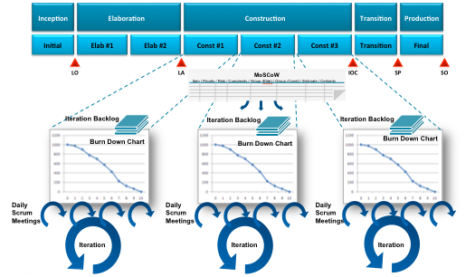
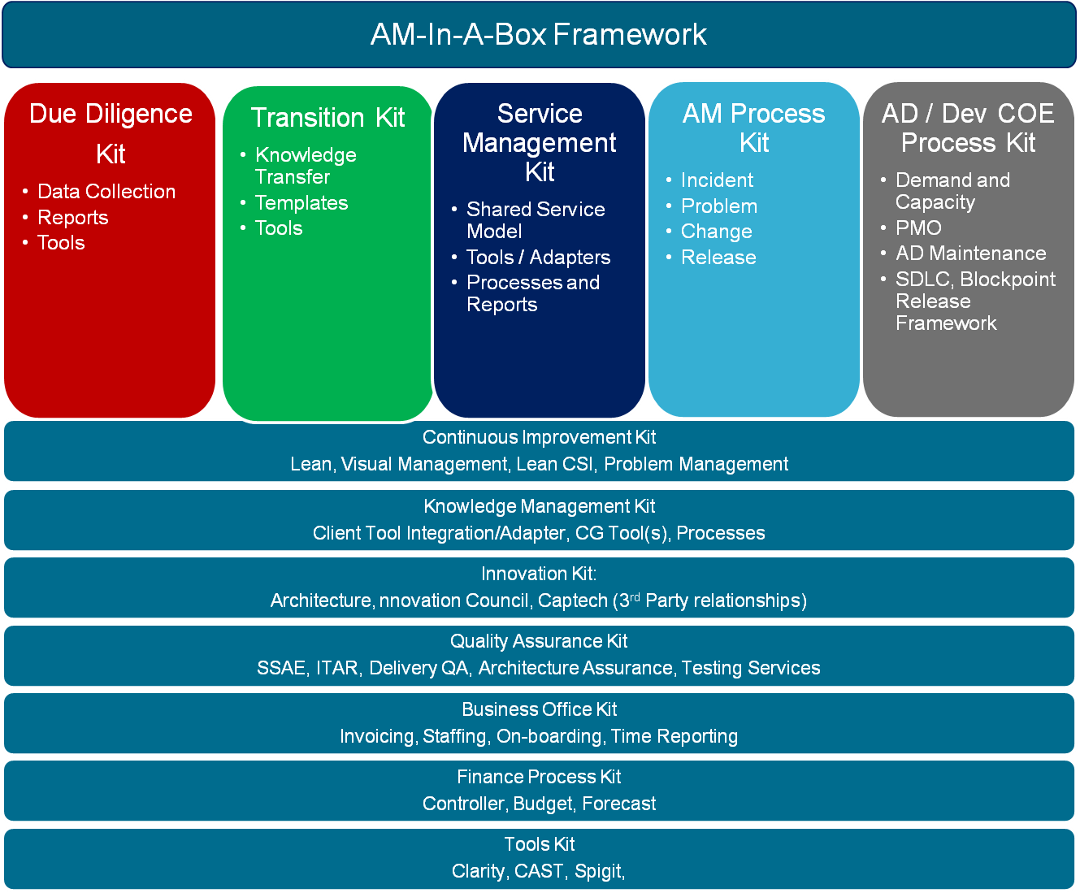
iUnify – Built on Agile Principles & Methods
Reduce Risk
Oracle Value Stream
Capgemini’s
iUnify
Agile Techniques
Flow & Standardized Work
Envision
Implement
Run
AM in a Box
Continuous Improvement
Eliminate Waste

Slide 28
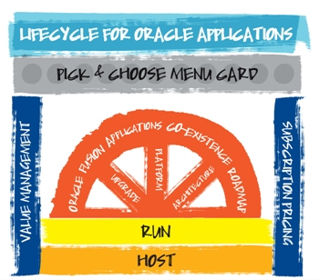
Lifecycle for Oracle Applications: A Comprehensive Suite of Solutions Along the Entire Lifecycle
Value Management Comprising all components across the entire lifecycle focused on both value generation and cost reduction
Pre-Configured Solutions
Available as Pre-Configured on Oracle’s Engineered Systems (On-Premise or Hosted) as well as available in SaaS Models
Oracle Integration Includes common integration services according to best practices utilizing Oracle Fusion Middleware
Oracle Upgrade Moving onto the latest technology platform, leveraging Capgemini’s industrialized model without disruption
Oracle Run Staff augmentation, full application management, level 2 and 3 support and specific industrial models with creative support options including per ticket, hours based, or SLA pricing
Offering both CAPEX and OPEX
In case of OPEX, monthly fixed fee over a period of 3 to 5 years
Oracle SingleSource bundles licenses, build, hosting, and run together in one contract.
Oracle Hosting
On-premise with client hardware and/or private cloud via Capgemini Cloudburst
Off-premise via Public Cloud via Amazon Web Services or via Capgemini Hosting
… and we can operate a true platform based BPO that drives long-term recurring savings to fund innovative and rapid Oracle implementations

Slide 29
Oracle SingleSource*: A Unique way for Customers to Accelerate ROI on Oracle from Capgemini
Capgemini’s Oracle solutions offer a full range of lifecycle support options, reduced complexity and flexible pricing
License
Implement
Infrastructure
Run
Operate
Simplify solution footprint with pre-configured solutions and infrastructure options to fit specific needs
Gain additional financial and cash flow flexibility based on specific financial needs
Accelerate ROI by reducing time to benefit with rapid deployment methodology
OPEX and CAPEX models available
Capgemini can license all products in which we are Specialized
Thoughtful and practical guidance on your licensing strategy
HCM Fusion/PeopleSoft
CX/CRM
SCM Fusion
OTM/Demantra
Manufacturing (Chrome)
tPolice/tGov
Public Cloud
Staff Augmentation
F&A BPO
Private Cloud
Virtual Private Cloud
Full Application Management
Procurement BPO
On-Premise Cloud
Level 2 or 3 Support
HR BPO
Traditional On-Premise Hardware or Outsourced
Bundle Oracle software with our services
Unique way to consume Oracle from Capgemini
Each solution compatible with our Global Process Model
Continuous improvement and new models under development
Each solution SaaS-capable
Flexible delivery models
Hybrid infrastructure combinations via Capgemini COMPLETE cloud platform
Scalability via public or private Cloud, on or off-premise
Flexible support options including per ticket, hours based, or SLA pricing
True platform-based BPO
Drive hard dollar savings to fund the Oracle implementation and lock in recurring, long-term saving
*SingleSource name under review

Slide 30
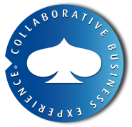

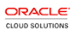







Oracle Global Delivery Center (Offshore)
GLOBAL HC
India HC
Industrialized Delivery Platform (IDP)
1540
780
500
200
Over 65% of resources are certified consultants
700
250
Functional: Technical ratio is 1:5 ;
All Resources Aligned To Competency
955
435
Resources are clustered in Mumbai & Bangalore;
20% Bench Maintained at all times
Average experience level of our resources is 5+
Strong Team Delivering Value for
Resource movements across AD & AM projects
for seamless delivery
Focus on Innovation, Industrialization, Intimacy in Delivery,
Capability Enhancement, and Service Offerings
Industrialized Delivery Platform(IDP) enables seamless delivery, fine-grained delivery governance and competency development.

Slide 31
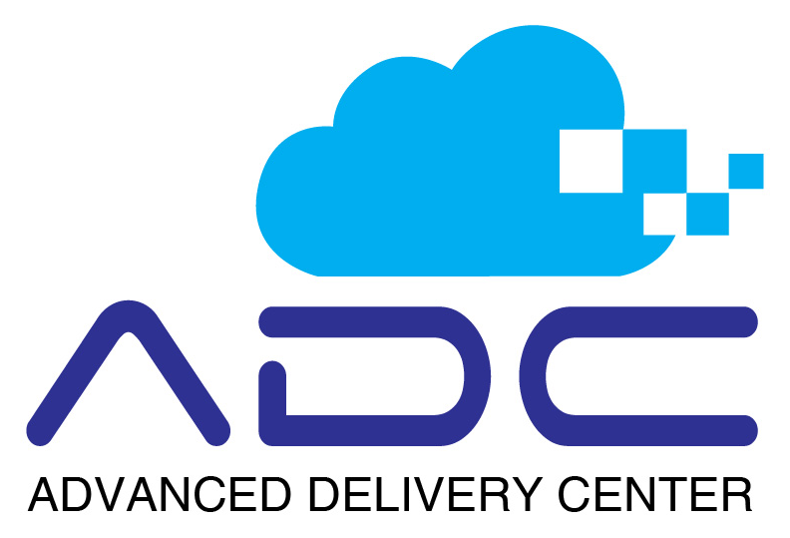
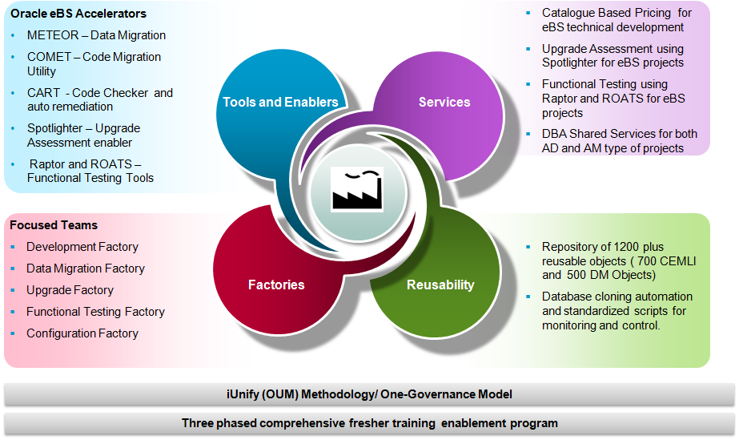
IDP’s Advanced Delivery Center for Reliability and Maximum Customer Value

Slide 32


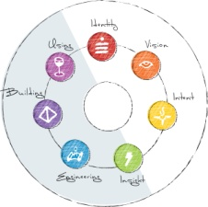


We Make Better Decisions
For over half of Fortune 100 companies, Capgemini’s Accelerated Solutions Environment® provides a different way of working. This creative workspace combined with a patented facilitation approach allows you to solve complex problems, develop a broad set of solution champions, and generate enormous momentum aimed at your project goals.
make business decisions in hours and days, rather than months and years
unleash group genius to craft a more robust and creative solution than any individual effort
mobilize diverse stakeholders to implement collectively created solutions
reduce rework and extended feedback cycles to accelerate signoff
“In my 14 years of IT experience, I have never seen anything like the ASE to quickly get buy-in and map out a major initiative, in 48 hours.”
- Client Sponsor

Slide 33
Table of Contents
Capgemini Oracle Practice Overview
Analyst Reporting
Methodology & Delivery Models
Solutions & Accelerators

Slide 34
Oracle Partner SAM Program
Oracle Partner SAM Program for Capgemini provides Capgemini with leading edge information on Oracle products and a direct link into Oracle Development and Support
Program Highlights:
Global Region Focused (NA, EMEA, APAC)
Provide the most up-to-date positioning and enablement for Oracle’s fastest growing products:
Latest Revisions of Apps Unlimited (EBS, PSFT, Siebel)
Fusion Middleware
Multi-Pillar Solutions: e.g. Edge Apps, EPM-Hyperion
Fusion Applications
Oracle Development and Support engagement with Capgemini project management as needed through lifecycle of project
Oracle Development advice and feedback on top priority functional gap areas
Oracle Development and Support special attention to top product issues
Escalation Management within Oracle Support and Development through Oracle Primary Point of Contact

Slide 35
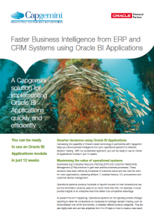
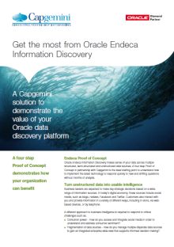
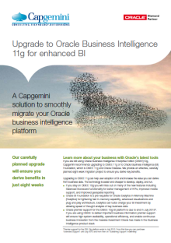
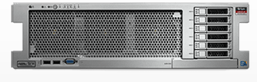
Oracle Analytics Drive Innovation
Global Oracle BI Practice
Global Oracle BI practice with strong capabilities and thought leadership
Ranked #1 Oracle BI partner in Europe, #2 in NA
Successfully completed more than 500 Oracle BI, BI Apps, EPM and Data warehousing projects
Over 1200 Oracle BI & EPM experts located throughout Europe, Asia, and North America
Over 18 approved Oracle approved Analytics and BI Solutions
First Oracle Advanced Specialized BI Partner
Capgemini’s Christian Screen and Marty Mersinger recognized as Oracle Deputy CTO for BI expertise and contributions
Core Offerings
Big Data Discovery powered by Endeca
Industry-specific solutions
8-week deployment models bundled with customer training
Great wedge to developing business relationships
OBIEE Migrations and Upgrades
OBIEE 11g Upgrade
Offerings to migrate from other BI tools to OBIEE (CoE and Accelerators)
Oracle BI Applications
Maximize value of operational systems for both ERP and CRM
BI Application Deployment Packs
12-week accelerators
Deployed with BICG IP
High user adoption, successful deployments and continuous BI Service Center revenue stream
Exalytics Center of Excellence
Proof of Concepts using Capgemini Exalytics box
In-Memory Analytics to analyze data at the speed of thought
Significant reduction in infrastructure needed for overall analytics environment
Thought Leadership

Slide 36
OracleTesting COE
Create Oracle testing Accelerators or workbenches with Blueprint Requirement Center™
Jointly work with Oracle Service Line to deliver Oracle product testing as a shared service to internal projects and external customers
Address testing needs of all Oracle products
Alignment with Oracle
Service Line
Workbench development
Recruitment
&
Staffing
POCs with
HP, IBM
or Oracle
ATS tooling
Closely work with Staffing team to assign resources for accounts
OracleTesting
COE
Create POCs to aid customer confidence on tooling
Training &
Knowledge
Management
Methodology
&
Processes
Collate and improve on Templates, Checklists and guideline documents
Create Best Practices for Various tools
Training testers on Oracle product, Siebel modules for projects
Manage knowledge artifacts
Pre-Sale
Activities
Create/Update Oracle Testing Capabilities deck
Testing effort estimation for Oracle products implementation / upgrade projects
Working on Proposals
Collate and maintain case studies and numbers

Slide 37

Developed with Industry Leading Practices and Business Processes
Horizontals
Upgrade Labs and Offerings
PeopleSoft, EBS, Siebel and OBIEE
Fusion Technology
SOA Center of Excellence
Oracle Database Rationalization
Exadata Center of Excellence
HCM
Fusion HCM package offerings
HCM Process Transformations
Analytics
Big Data Discovery
OBIEE Migrations
Oracle BI Application Deployment Packs
Exalytics Center of Excellence
Supply Chain
Fusion SCM (DOO/GOP)
Move: OTM/TMS Now
Plan: Demantra/Trade Promotion Management
Buy: Fusion Procurement / iProcurement
CX/CRM Offerings
Sales, Service, Marketing and CPQ Cloud
360* Customer Data Management
Siebel Innovation Offerings (User Engagement and Mobility)
Verticals
Communications Transformation Platform
Distribution Execution Services
(TMS Now, Buyer’s Workbench and Seller’s Workbench for Distribution-Intensive Companies)
Manufacturing Execution Services (Chrome)
OCommerce (Retail, CPG)
Transformation Police (tPolice)
Transformation Government (tGov)
Unemployment Insurance Revenue Management
Audience Analytics (Media, Entertainment)
Tax& Welfare
Smart Cities
Cloud Applications
Sales Cloud IMPACT
ERP Cloud IMPACT approach
Global Launch of Oracle ERP Cloud: Financials Suite
HCM Cloud IMPACT (version 2)
Oracle Fusion CX/DOO Solution
Non-Fusion Focus: Marketing Cloud, Service Cloud and CPQ Cloud
Internal: Global Oracle Cloud Repository
Engineered System
Solution Set: a)Infrastructure Services; b) Applications; c)BI
COE: global COE for engineered systems
IP: Capgemini t-Police IP solution certified on engineered systems (exa-ready)
Capgemini OCommerce IP solution getting certified on engineered systems (exa-ready)
Three other Capgemini IP solutions are currently in internal review
BIM
Core OBIEE and BI Applications
BI Service Center
Roadmap to 12c and Big Data
Asset Analytics
Key Innovations

Slide 38




Oracle Solution Center – Industry Focus
Industry Solutions (CapgeminiDIRECT)
EnergyDIRECT
DistributionDIRECT
GSDIRECT
RetailDIRECT – CX
A comprehensive solution for Oil and Gas industry which incorporates leading practices developed from our extensive legacy of Capgemini led Oracle implementation
The solution caters to multiple industries and provides seamless integration with Oracle EBS/ WMS /OTM application portfolio. This also includes pre-built industry and geography specific leading practices based model
MfgDIRECT
MFGDirect solution fits industrial manufacturers and automotive clients. It has process models, pre-configured instance, testing and deployment accelerators. Our plan is to build the phase 2 of the solution while Phase 1 is already operational.
Complete kit for on boarding Government agencies into Oracle Applications. This is ready to use. Currently we are planning for further extension of the solution covering SMIC and Cash Management
Co-developed with FS
FSDIRECT
.
FAH-OFSAA-GL Integration Solution for Enterprise Risk Management, Governance, Risk & Compliance / FCCM. Phase 1 (T24/Loan products) is released. Working with FS Team for Phase 2
Building this solution on top of OCommerce (ATG, Endeca, ServiceCloud, DOO + integration to EBS) Work in progress. Using IKEA footprint for the development of the solution
UtilityDIRECT
The solution is targeted for the Utility industry and is being developed by the CALORIE team. We are working with them in consolidating the Oracle solution under the Solution Center. Phase 1 (Back office EBS/PSFT Non UGBU product set) is completed. Waiting on Global/NA funding for Phase 2 (Operational Device Mgmt, Smart Meters Firmware upgrade, Work and Assess Mgmt, MDM)
Cloud Delivery Platform (CDP)
We will introduce one of the most comprehensive offerings from Oracle IDP, The Cloud Delivery Platform (CDP), in 2015. The CDP is the delivery of Services of an Oracle product through an infrastructure hosted in a private cloud environment. The offering will be tailored to include either one or a combination of Software as a Service (SaaS), Infrastructure as a Service (IaaS), Platform as a Service (PaaS), Communications as a service (CaaS) or Monitoring as a service (Maas).

Slide 39




Oracle Solution Center – Technology Accelerators
Preconfigured Package Solutions (CapgeminiADVANTAGE)
HCMAdvantage
CRMAdvantage
Helps in smooth transition from on-premise HCM Application to Oracle HCM Cloud application. Apart from our pre-configured HCM Cloud environment with industry best business processes and use cases, the solution comes with a set of configuration workbooks, ready-to-use mapping, configuration template
and scripts for HCM Cloud application.
CRMAdvantage is an end-to-end solution that leverages customers' existing Oracle legacy systems as well as the embedded business intelligence and social media functions of the Oracle Sales Cloud to help your organization rapidly transform its business.
EAMAdvantage
BPMAdvantage
This solution will aim to complete the journey of an organization from EAM point solution to an integrated ERP. This will facilitate the above migration in a much accelerated pace than a traditional implementation. In addition to that the solution will help in departmental billing and charge back functionality and provide a Single Sign On feature using Oracle Identity federation.
This pre-configured integration solution will be designed to help our customers to make their core processes leaner, more flexible, and more efficient. The solution’s Self Service functionality and robust case management capability will help the business users, IT specialists, and system administrators to work together under ideal conditions along the whole process chain, with no loss of efficiency due to media discontinuities.
Productivity Improvement Tools and Point Solutions (VAULT)
EBS Enablers
PeopleSoft Enablers
Point Solutions
Legends
AUTOFORM
CART
CAPSULE
RAFT
CAPTURE
CSL
Completed
RAPTOR
SPEED
PART
SPOT LIGHTER
CLOSEIT
MOSS
In Progress
COMET
METEOR
Methodologies (LEAP)
IMPACT (Cloud Implementation)
UPSTREAM (Upgrade Methodology)
ROATS

Slide 40














Capgemini Cities Framework – Retaining Perspective Whilst Focusing on Specifics
Integrating solutions across multiple domains to transform city outcomes
Sustained Collaborative Leadership
Mobility
Electric Vehicles
Smart Grid
Public Administration
Health & Social Care
Smart Buildings
Place
Economy
Community Generation
Smart Meter
Digital Utilities
Learning
Connectivity
Security
Digital Cities
Digitisation & Innovation
Sustainability
Customer Insight & Engagement

Slide 41

Mobile Solutions: Your Business. Always On.
As your Enterprise Mobility Orchestrator, we provide 5 solutions that guide you through your journey to mobility.
Mobile Strategy
Mobile Applications
Managed Mobility
Mobile Platforms
Reselling
Enterprise Mobility Orchestrator
1
Enterprise Mobility Targets
Mobile Customer
Mobile Worker
Machine-to-Machine
2
3
Enterprise Mobility Orchestrator
4
Strategy
Mobile Applications
Managed Mobility
Mobile Platforms
Reselling
5
Vendor Ecosystem
Mobile BI Strategy:
Roadmap Development and Socialization
Capture Business Drivers/Requirements Around Mobile BI
Recommendations Around Delivery/Methodology
Development:
Design, Development and Deployment of mobile BI dashboards/reports/KPI alerts
Implement Mobile BI Program to continually and effectively drive development and support
Architecture Design:
Mobile BI Platform Integration
Recommend/Implement Infrastructure Enhancements to support mobile BI
Device security assessment/recommendations
Industry Specific Development:
Design, Development and Deployment of mobile BI dashboards/reports focused on particular industry KPI’s
Utilize industry SME’s to discuss what other organizations are doing in the mobile space
Mobile BI ASE:
ASE Sessions designed to gain buy-in and consensus on approach for mobile analytics
Understand critical business requirements, prioritize key initiatives and build an enterprise roadmap in 1-2 days
Training Deployment and Strategy:
Mobile BI Developer and End User Tool Training
Mobile BI specific visualization training leveraging Capgemini RDV resources
Development of training artifacts for reuse

Slide 42
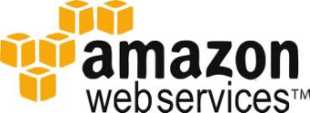




Intelligent COMPLETE Solutions
Capgemini
COMPLETE Platform
COMPLETE - Cloud Orchestration Management Platform End to End
Capgemini COMPLETE is an enterprise ready framework and intelligent platform that integrates and supports applications in the Cloud. Leveraging the power of Amazon Web Services (AWS), COMPLETE “abstracts” the complexity of multiple Cloud and non-Cloud infrastructures and presents to the enterprise the same look and feel as if the Oracle ecosystem was running in their datacenter.
COMPLETE includes everything needed:
Infrastructure, management, Cloud orchestration, support, consolidated billing, and maintenance - for running your Oracle ecosystem on a Cloud or multiple Cloud environments.
Cost-effective platform with a consumption based, pay as you go model.
Ability to run multiple Oracle applications in a consolidated platform with built-in Cloud intelligence.
Maximum flexibility including the ability to expand and contract, leveraging its Cloud abstraction and aggregation (Hybrid Cloud) abilities.
2013 AWS Premiere Consulting Partner
Cloud Computing Center of Excellence with AWS trained and educated personnel
Amazon Web Services Certified to Run Oracle Applications and Technology Products on Linux
Services around the AWS Cloud
Cloud Development Services
Cloud Consulting Services, Cloud Managed Services, Cloud Migration Services, Readiness Assessment, Cloud DR & Backup Services
Success Story on Oracle/AWS

